Slide 1
Delivery and Forwarding of IP Packets
TCP/IP Protocol Suite
Copyright © The McGraw-Hill Companies, Inc. Permission required for reproduction or display.

Slide 2
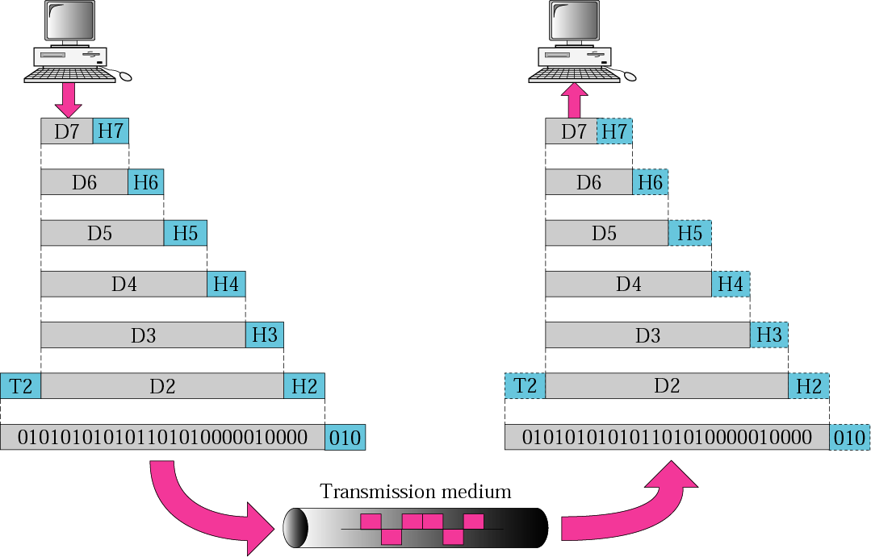
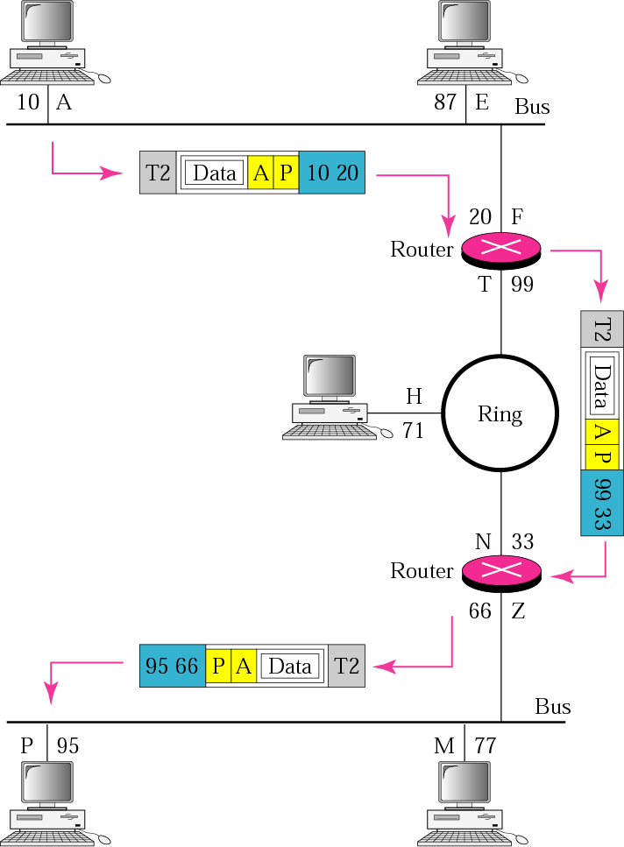
TCP/IP Protocol Suite

Slide 3
6-1 DELIVERY
The network layer supervises the handling of the packets by the underlying physical networks.
We define this handling as the delivery of a packet.
Delivery of a packet to its final destination is accomplished using two different methods of delivery:
  direct
  indirect.
TCP/IP Protocol Suite

Slide 4
Direct delivery
In a direct delivery, the final destination of the packet is a host connected to the same physical network as the deliverer.
Direct delivery occurs when the source and destination of the packet are located on the same physical network or if the delivery is between the last router and the destination host
TCP/IP Protocol Suite

Slide 5
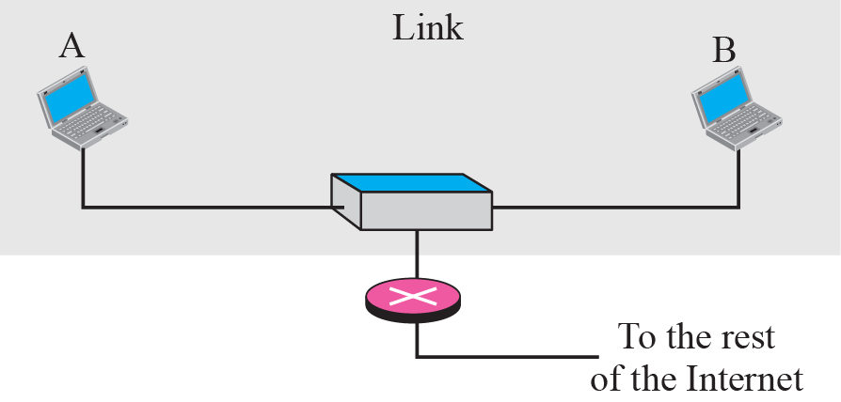
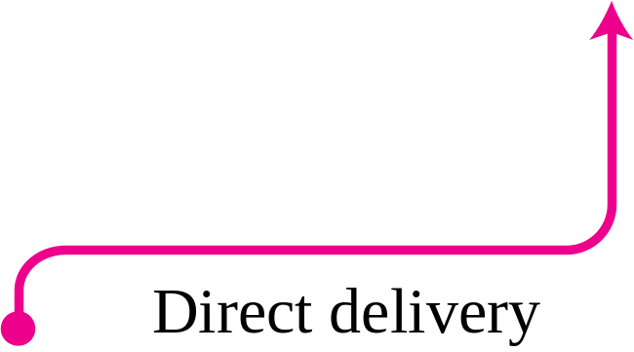
Figure 6.1 Direct delivery
TCP/IP Protocol Suite

Slide 6
Direct delivery
The sender can easily determine if the delivery is direct.
It can extract the network address of the destination (using the mask) and compare this address with the addresses of the networks to which it is connected.
If a match is found, the delivery is direct.
In direct delivery, the sender uses the destination IP address to find the destination physical address.
The IP software then gives the destination IP address with the destination physical address to the data link layer for actual delivery.
TCP/IP Protocol Suite

Slide 7
Indirect delivery
If the destination host is not on the same network as the deliverer, the packet is delivered indirectly.
In an indirect delivery, the packet goes from router to route reaches the one connected to the same physical network as its final destination.
TCP/IP Protocol Suite

Slide 8
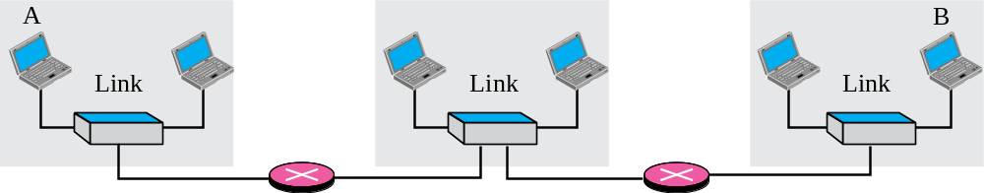
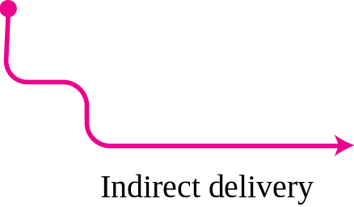
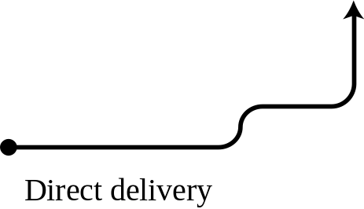

Figure 6.2 Indirect delivery
TCP/IP Protocol Suite

Slide 9
Indirect delivery
In an indirect delivery, the sender uses the destination IP address and a routing table to find the IP address of the next router to which the packet should be delivered.
The sender then uses ARP to find the physical address of the next router.
In direct delivery, the address mapping is between the IP address of the final destination and the physical address of the final destination.
In an indirect delivery, the address mapping is between the IP address of the next router and the physical address of the next router.
Delivery always involves one direct delivery but zero or more indirect deliveries.
TCP/IP Protocol Suite

Slide 10
6-2 FORWARDING
Forwarding means to place the packet in its route to its destination.
Internet today is made of a combination of links (networks), forwarding means to deliver the packet to the next hop (which can be the final destination or the intermediate connecting device).
IP protocol was originally designed as a connectionless protocol, today the tendency is to use IP as a connection-oriented protocol.
When IP is used as a connectionless protocol, forwarding is based on the destination address of the IP datagram;
when the IP is used as a connection-oriented protocol, forwarding is based on the label attached to an IP datagram
TCP/IP Protocol Suite

Slide 11
Forwarding Based on Destination Address
In this case, forwarding requires a host or a router to have a routing table.
When a host has a packet to send or when a router has received a packet to be forwarded, it looks at this table to find the route to the final destination.
This simple solution is inefficient today in an internetwork such as the Internet because the number of entries needed in the routing table would make table lookups inefficient.
TCP/IP Protocol Suite
Notes:
Reduce the contents of the RT

Slide 12
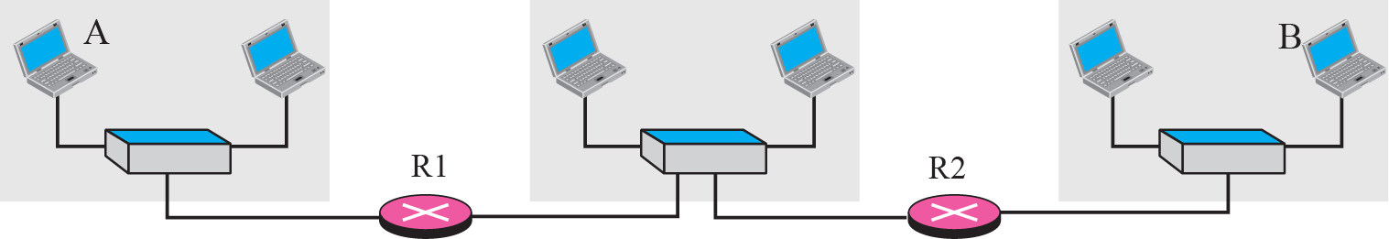
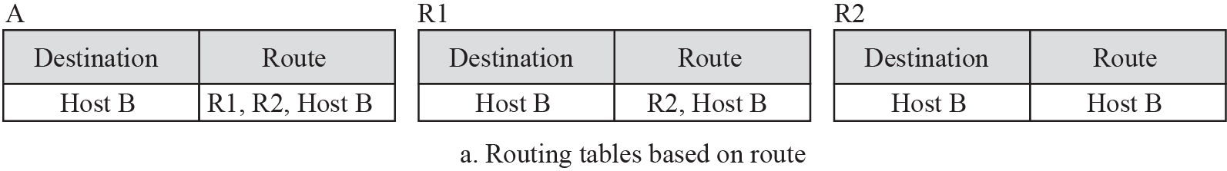
TCP/IP Protocol Suite
Notes:
Reduce the contents of the RT

Slide 13
Forwarding Techniques
Several techniques can make the size of the routing table manageable and also handle issues such as security.
Next-Hop Method
One technique to reduce the contents of a routing table.
Here, the routing table holds only the address of the next hop instead of information about the complete route.
TCP/IP Protocol Suite
Notes:
Reduce the contents of the RT

Slide 14
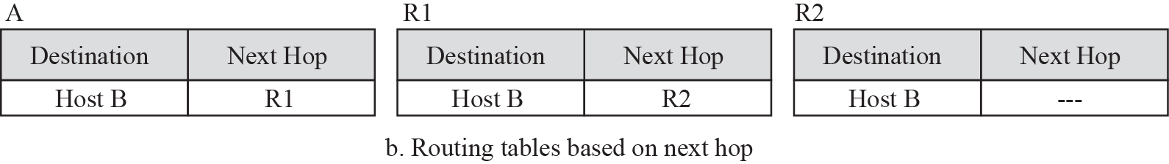
Figure 6.3 Next-hop method
TCP/IP Protocol Suite
Notes:
Reduce the contents of the RT

Slide 15
Network-specific method
Another techniques to reduce the routing table and simplilify the searching process.
Here, instead of having an entry for every destination host connected to the same physical network, we have only one entry that defines the address of the destination network itself.
Treat all hosts connected to the same network as one single entity.
TCP/IP Protocol Suite

Slide 16
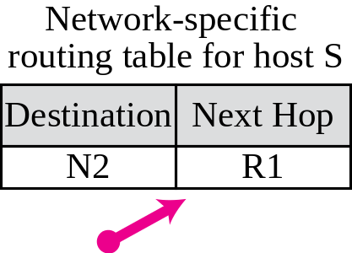
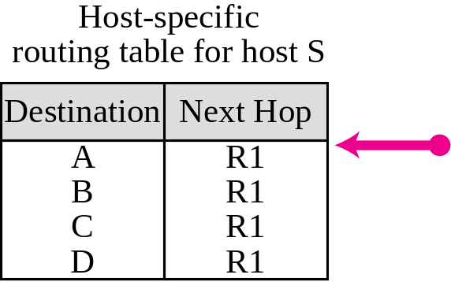
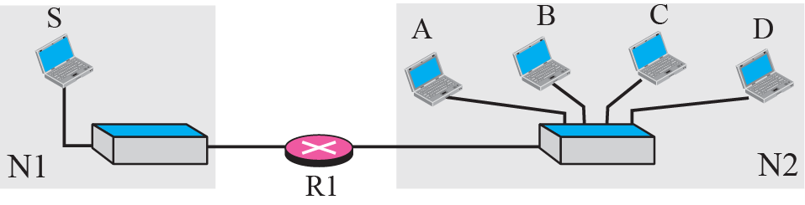
Figure 6.4 Network-specific method
TCP/IP Protocol Suite

Slide 17
Host-specific Method
In the host-specific method, the destination host address is given in the routing table.
Here efficiency is sacrificed for other advantages: There are occasions in which the administrator wants to have more control over routing.
For example, if the administrator wants all packets arriving for host B delivered to router R3 instead of R1, one single entry in the routing table of host A can explicitly define the route.
Host-specific routing is used for purposes such as checking the route or providing security measures.
TCP/IP Protocol Suite

Slide 18
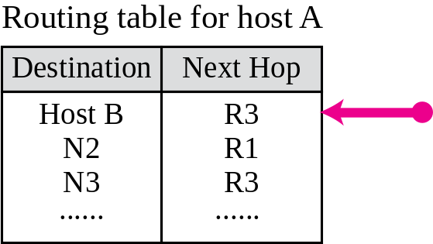
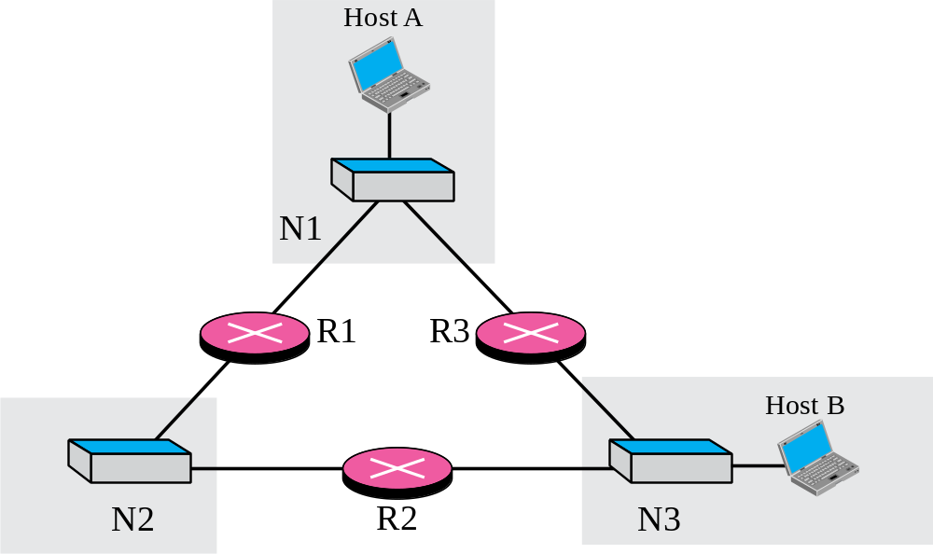
Figure 6.5 Host-specific routing
TCP/IP Protocol Suite

Slide 19
Default Method
Another technique to simplify routing is called the default method.
In Figure 6.6 host A is connected to a network with two routers. Router R1 routes the packets to hosts connected to network N2. However, for the rest of the Internet, router R2 is used.
So instead of listing all networks in the entire Internet, host A can just have one entry called the default (normally defined as network address 0.0.0.0).
TCP/IP Protocol Suite

Slide 20
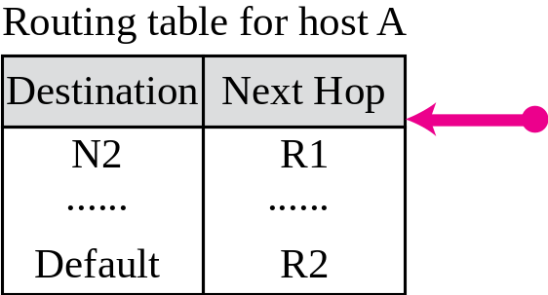
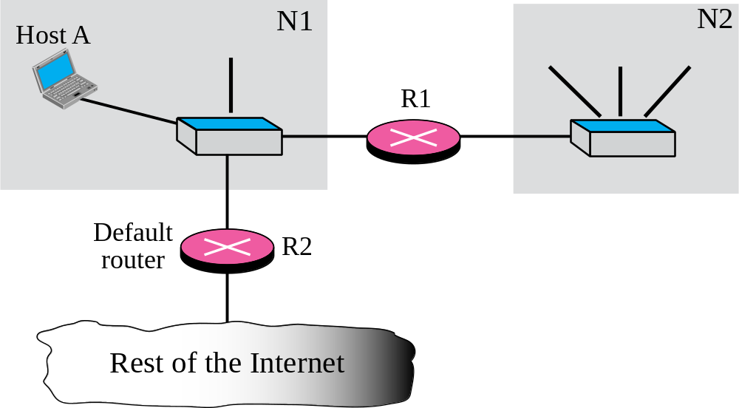
Figure 6.6 Default routing
TCP/IP Protocol Suite

Slide 21
Forwarding with classful addressing
classful addressing has several disadvantages.
However, the existence of a default mask in a classful address makes the forwarding process simple.
Discuss
Forwarding without subnetting : contents of a routing table and forwarding module for the situation in which there is no subnetting.
Forwarding with subnetting
TCP/IP Protocol Suite

Slide 22
Forwarding without Subnetting
In classful addressing, most of the routers in the global Internet are not involved in subnetting.
Subnetting happens inside the organization.
A typical forwarding module in this case can be designed using three tables, one for each unicast class (A, B, C).
If the router supports multicasting, another table can be added to handle class D addresses.
Having three different tables makes searching more efficient
TCP/IP Protocol Suite

Slide 23
Forwarding without Subnetting
Each routing table has a minimum of three columns:
The network address of the destination network.
The next-hop address tells us to which router the packet must be delivered for an indirect delivery. This column is empty for a direct delivery.
The interface number defines the outgoing port from which the packet is sent out.
TCP/IP Protocol Suite

Slide 24
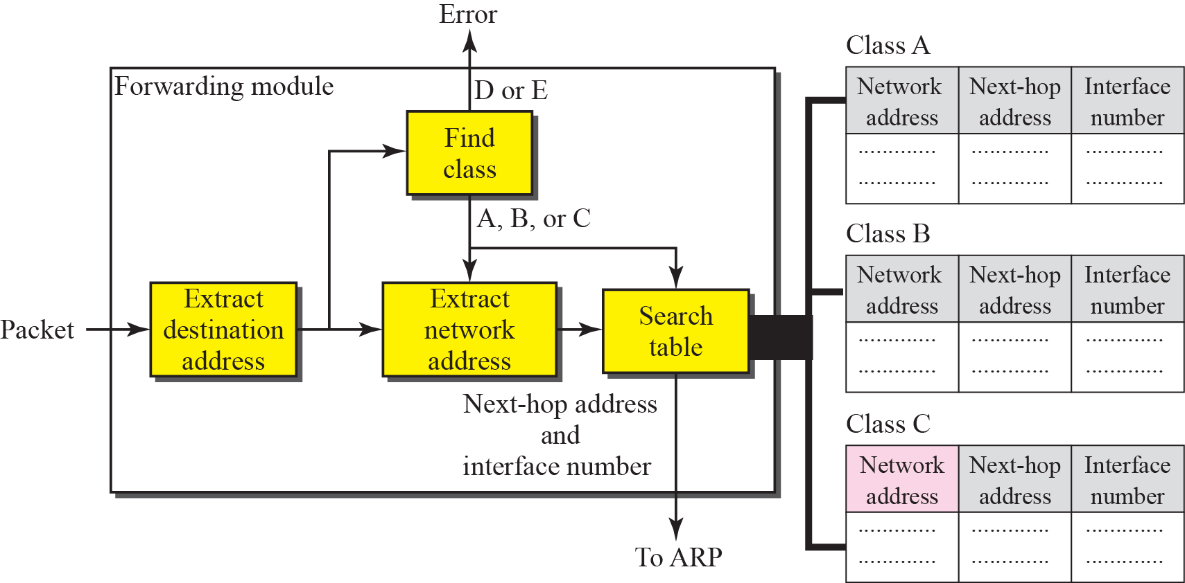
Figure 6.7 Simplified forwarding module in classful address without subnetting
TCP/IP Protocol Suite

Slide 25
Forwarding without Subnetting
The forwarding module follows these steps:
The destination address of the packet is extracted.
A copy of the destination address is used to find the class of the address. This is done by shifting the copy of the address 28 bits to the right. The result is a 4-bit number between 0 and 15. If the result is
  0 to 7, the class is A.
  8 to 11, the class is B.
  12 or 13, the class is C .
  14, the class is D.
  15, the class is E.
3. The result of Step 2 for class A, B, or C and the destination address are used to extract the network address. This is done by masking off (changing to 0s) the rightmost 8, 16, or 24 bits based on the class
TCP/IP Protocol Suite

Slide 26
Forwarding without Subnetting
4. The class of the address and the network address are used to find next-hop information. The class determines which table is to be searched. The module searches this table for the network address. If a match is found, the next-hop address and the interface number of the output port are extracted from the table. If no match is found, the default is used.
5. The ARP module uses the next-hop address and the interface number to find the physical address of the next router. It then asks the data link layer to deliver the packet to the next hop.
TCP/IP Protocol Suite

Slide 27
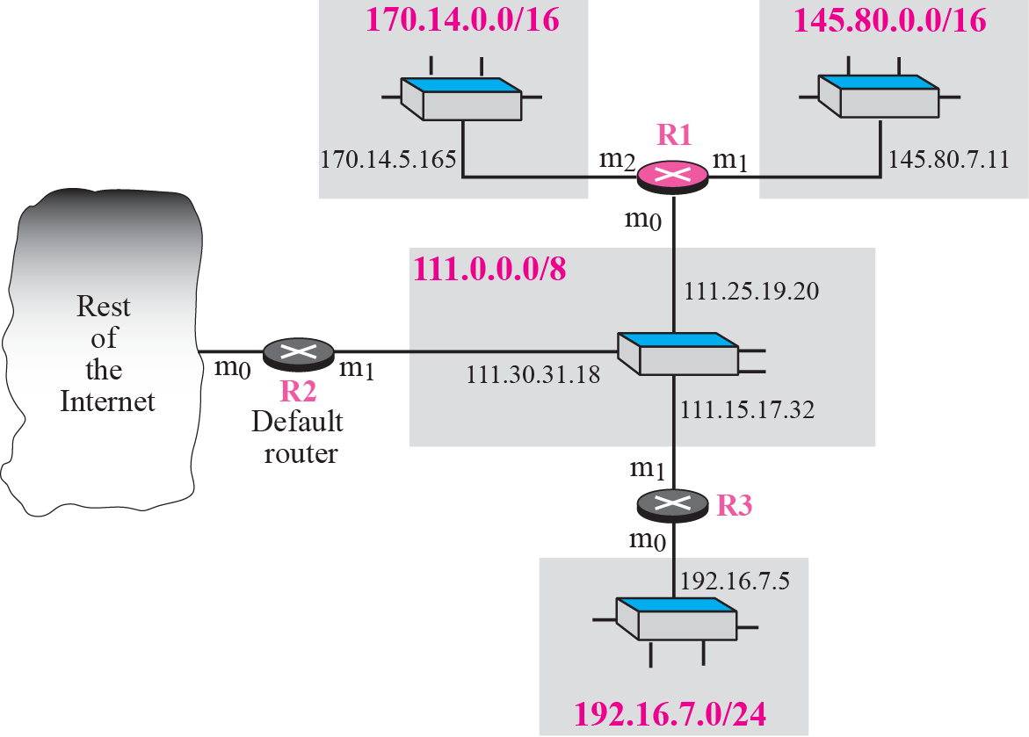
Figure 6.8 Configuration for routing, Example 6.1
Figure 6.8 shows an imaginary part of the Internet. Show the routing tables for router R1.
TCP/IP Protocol Suite

Slide 28
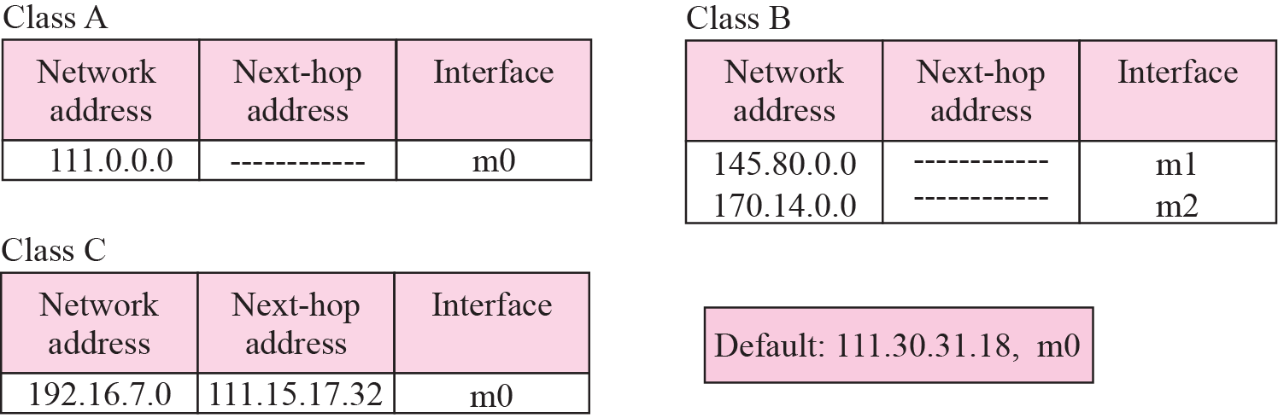
Example 6.1
Solution
The three tables used by router R1.
some entries in the next-hop address column are empty because in these cases, the destination is in the same network to which the router is connected (direct delivery).
TCP/IP Protocol Suite

Slide 29
Example 6.2
Router R1 in Figure receives a packet with destination address 192.16.7.14. Show how the packet is forwarded.
TCP/IP Protocol Suite

Slide 30
Example 6.2
Solution
The destination address is
11000000 00010000 000001110 0001110.
A copy of the address is shifted 28 bits to the right. The result is
00000000 00000000 00000000 00001100 or 12.
The destination network is class C.
The network address is extracted by masking off the leftmost 24 bits of the destination address; the result is 192.16.7.0.
The table for Class C is searched.
The network address is found in the first row. The next-hop address 111.15.17.32. and the interface m0 are passed to ARP.
TCP/IP Protocol Suite

Slide 31
Example 6.3
Router R1 in Figure receives a packet with destination address 167.24.160.5. Show how the packet is forwarded.
TCP/IP Protocol Suite

Slide 32
Example 6.3
Solution
The destination address in binary is
10100111 00011000 10100000 00000101.
A copy of the address is shifted 28 bits to the right. The result is
00000000 00000000 00000000 00001010 or 10.
The class is B.
The network address can be found by masking off 16 bits of the destination address, the result is 167.24.0.0.
The table for Class B is searched. No matching network address is found.
The packet needs to be forwarded to the default router (the network is somewhere else in the Internet).
The next-hop address 111.30.31.18 and the interface number m0 are passed to ARP.
TCP/IP Protocol Suite

Slide 33
Forwarding with Subnetting
In classful addressing, subnetting happens inside the organization.
The routers that handle subnetting are either at the border of the organization site or inside the site boundary.
If the organization is using variable-length subnetting, we need several tables; otherwise, we need only one table.
TCP/IP Protocol Suite

Slide 34
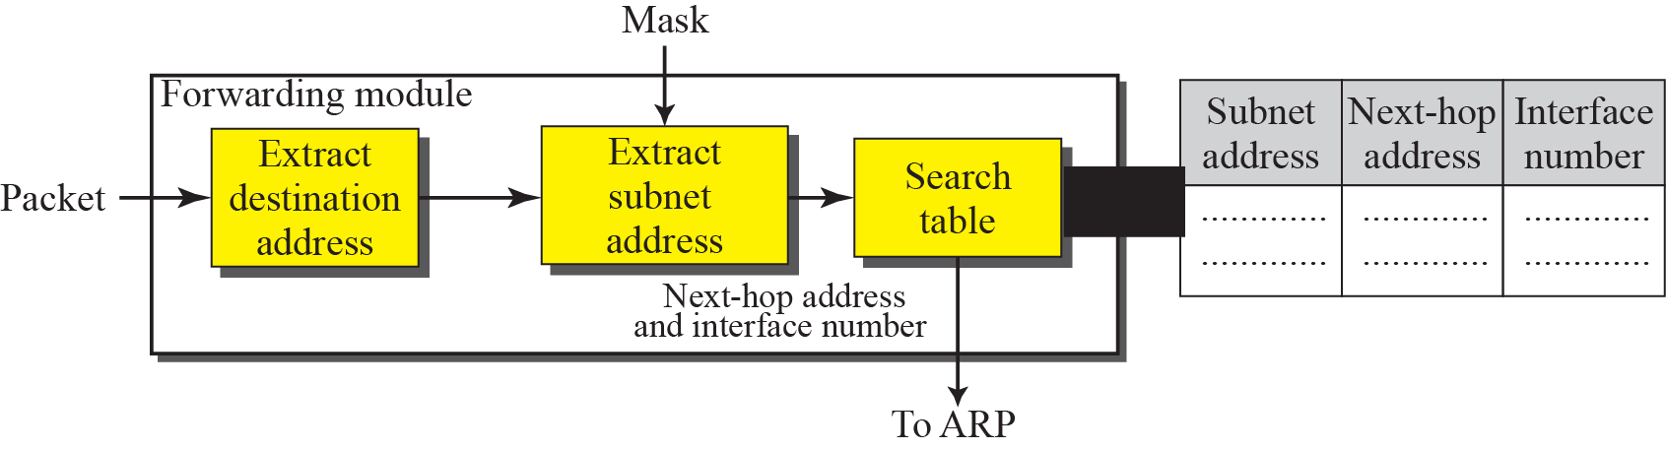
Figure 6.10 Simplified forwarding module in classful address with subnetting
Figure 6.10 shows a simplified module for fixed-length subnetting
TCP/IP Protocol Suite

Slide 35
Forwarding with Subnetting
The module extracts the destination address of the packet.
If the destination address matches any of the host-specific addresses in the table, the next-hop and the interface number is extracted from the table.
The destination address and the mask are used to extract the subnet address.
The table is searched using the subnet address to find the next-hop address and the interface number. If no match is found, the default is used.
The next-hop address and the interface number are given to ARP .
TCP/IP Protocol Suite

Slide 36
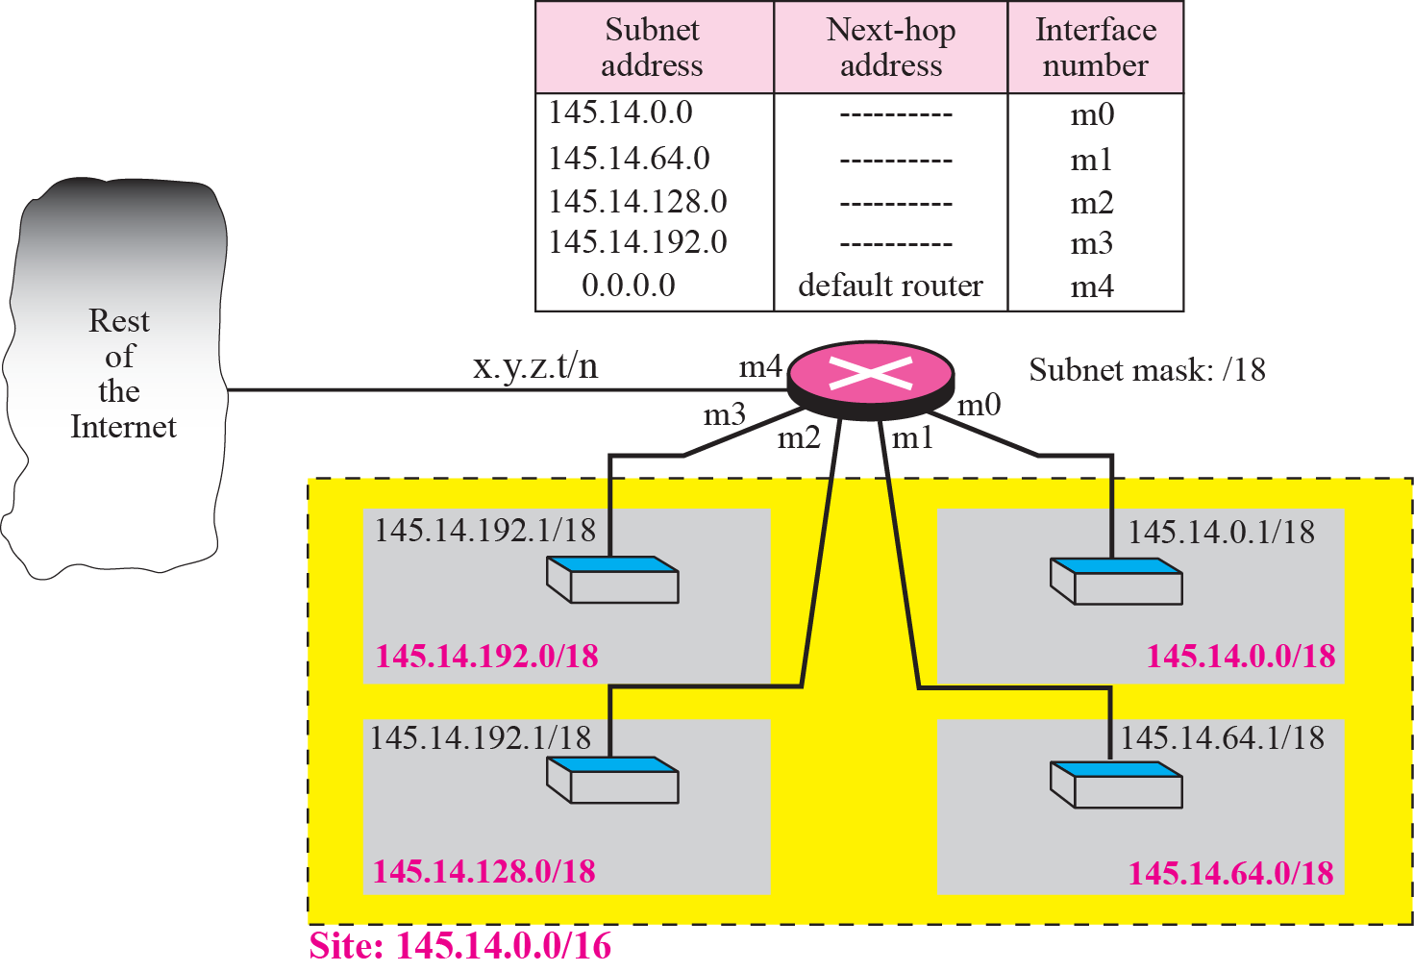
Figure 6.11 Configuration for Example 6.4
Figure shows a router connected to four subnets.

Slide 37
Example 6.4
First, the site address is 145.14.0.0/16 (a class B address).
Every packet with destination address in the range 145.14.0.0 to 145.14.255.255 is delivered to the interface m4 and distributed to the final destination subnet by the router.
Second, the address x.y.z.t/n for the interface m4 because we do not know to which network this router is connected.
Third, the table has a default entry for packets that are to be sent out of the site. The router is configured to apply the subnet mask /18 to any destination address.
TCP/IP Protocol Suite

Slide 38
Example 6.5
The router in Figure receives a packet with destination address 145.14.32.78. Show how the packet is forwarded.
TCP/IP Protocol Suite

Slide 39
Example 6.5
Solution
The mask is /18. After applying the mask, the subnet address is 145.14.0.0.
The packet is delivered to ARP with the next-hop address 145.14.32.78 and the outgoing interface m0.
TCP/IP Protocol Suite

Slide 40
Example 6.6
A host in network 145.14.0.0 in Figure has a packet to send to the host with address 7.22.67.91. Show how the packet is routed.
TCP/IP Protocol Suite

Slide 41
Example 6.6
Solution
The router receives the packet and applies the mask (/18). The network address is 7.22.64.0.
The table is searched and the address is not found.
The router uses the address of the default router (not shown in figure) and sends the packet to that router.
TCP/IP Protocol Suite

Slide 42
Forwarding with Classless Addressing
Destination address in the packet gives no clue about the network address.
Need to include the mask (/n) in the table;
Need to have an extra column that includes the mask for the corresponding block.
classless routing table needs at least four columns.
TCP/IP Protocol Suite

Slide 43

Note
In classful addressing we can have a routing table with three columns;
in classless addressing,
we need at least four columns.
TCP/IP Protocol Suite

Slide 44
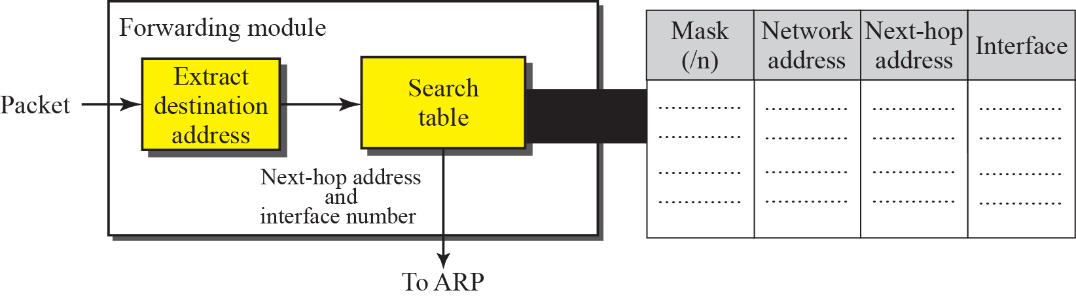
Figure 6.12 Simplified forwarding module in classless address
TCP/IP Protocol Suite

Slide 45
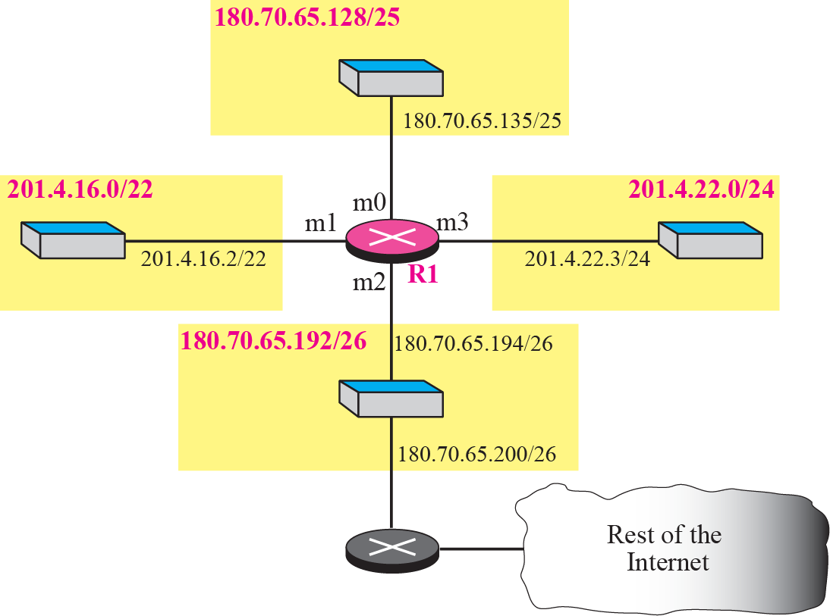
Example 6.7
Make a routing table for router R1 using the configuration in Figure.
TCP/IP Protocol Suite

Slide 46
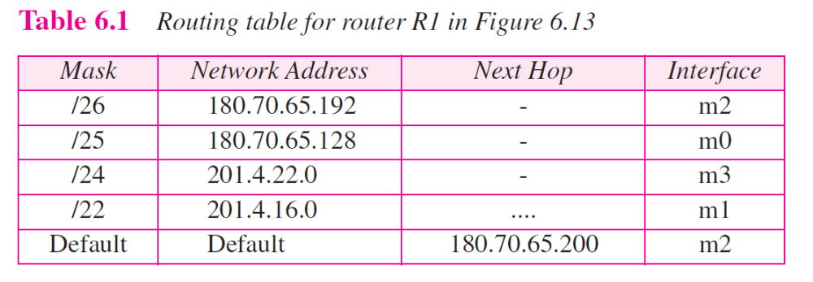
Example 6.7
Make a routing table for router R1 using the configuration in Figure 6.13.
Solution
TCP/IP Protocol Suite

Slide 47
Example 6.8
Show the forwarding process if a packet arrives at R1 in Figure with the destination address 180.70.65.140.
TCP/IP Protocol Suite

Slide 48
Example 6.8
Show the forwarding process if a packet arrives at R1 in Figure 6.13 with the destination address 180.70.65.140.
Solution
The router performs the following steps:
The first mask (/26) is applied to the destination address. The result is 180.70.65.128, which does not match the corresponding network address.
The second mask (/25) is applied to the destination address. The result is 180.70.65.128, which matches the corresponding network address.
The next-hop address (the destination address of the packet in this case) and the interface number m0 are passed to ARP for further processing.
TCP/IP Protocol Suite

Slide 49
Example 6.9
Show the forwarding process if a packet arrives at R1 in Figure with the destination address 201.4.22.35.
TCP/IP Protocol Suite

Slide 50
Example 6.9
Show the forwarding process if a packet arrives at R1 in Figure 6.13 with the destination address 201.4.22.35.
Solution
The router performs the following steps:
The first mask (/26) is applied to the destination address. The result is 201.4.22.0, which does not match the corresponding network address .
The second mask (/25) is applied to the destination address. The result is 201.4.22.0, which does not match the corresponding network address.
3. The third mask (/24) is applied to the destination address. The result is 201.4.22.0, which matches the corresponding network address.
The destination address of the packet and the interface number m3 are passed to ARP
TCP/IP Protocol Suite

Slide 51
Example 6.10
Show the forwarding process if a packet arrives at R1 in Figure with the destination address 18.24.32.78.
TCP/IP Protocol Suite

Slide 52
Example 6.10
Show the forwarding process if a packet arrives at R1 in Figure 6.13 with the destination address 18.24.32.78.
Solution
This time all masks are applied to the destination address, but no matching network address is found.
When it reaches the end of the table, the module gives the next-hop address 180.70.65.200 and interface number m2 to ARP.
This is probably an outgoing package that needs to be sent, via the default router, to someplace else in the Internet.
TCP/IP Protocol Suite

Slide 53
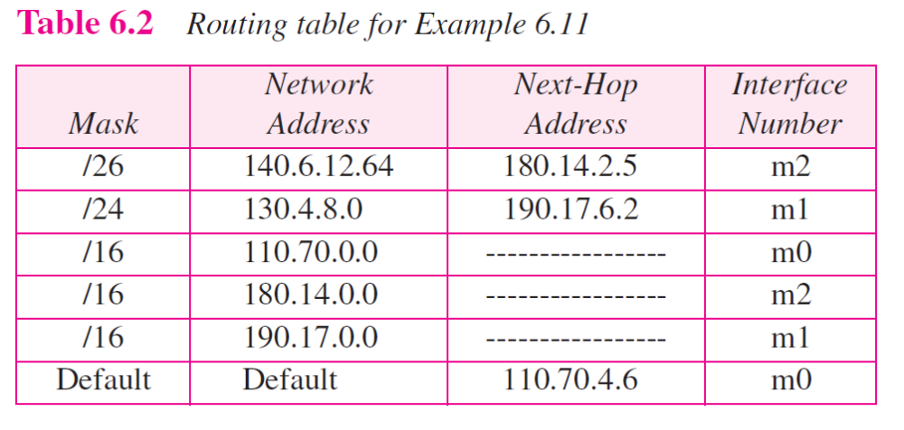
Example 6.11
The routing table for router R1 is given in Table 6.2. Draw its topology?
TCP/IP Protocol Suite

Slide 54
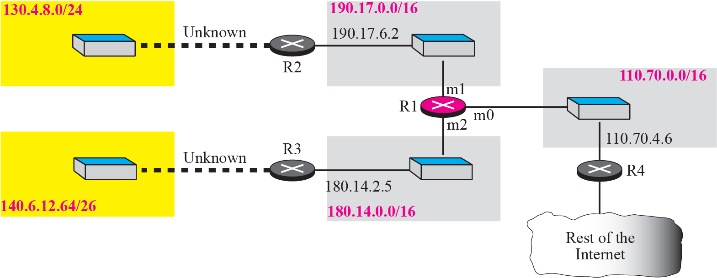
Figure 6.14 Guessed topology for Example 6.11
TCP/IP Protocol Suite

Slide 55
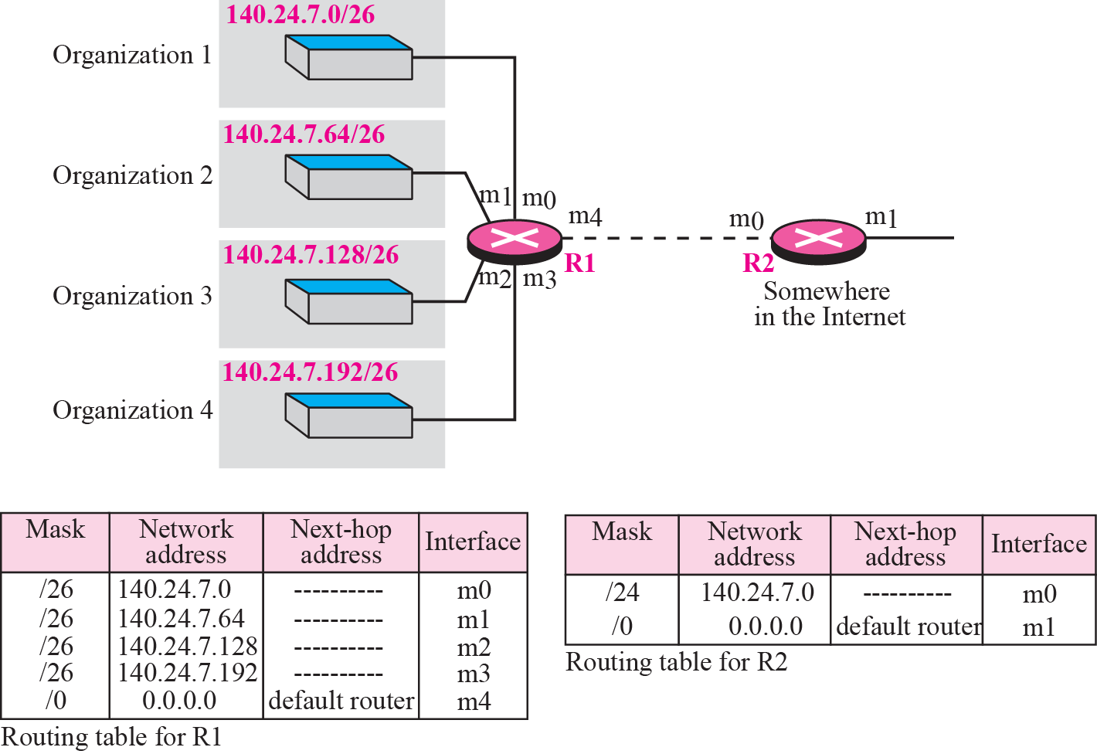
Address aggregation
TCP/IP Protocol Suite

Slide 56
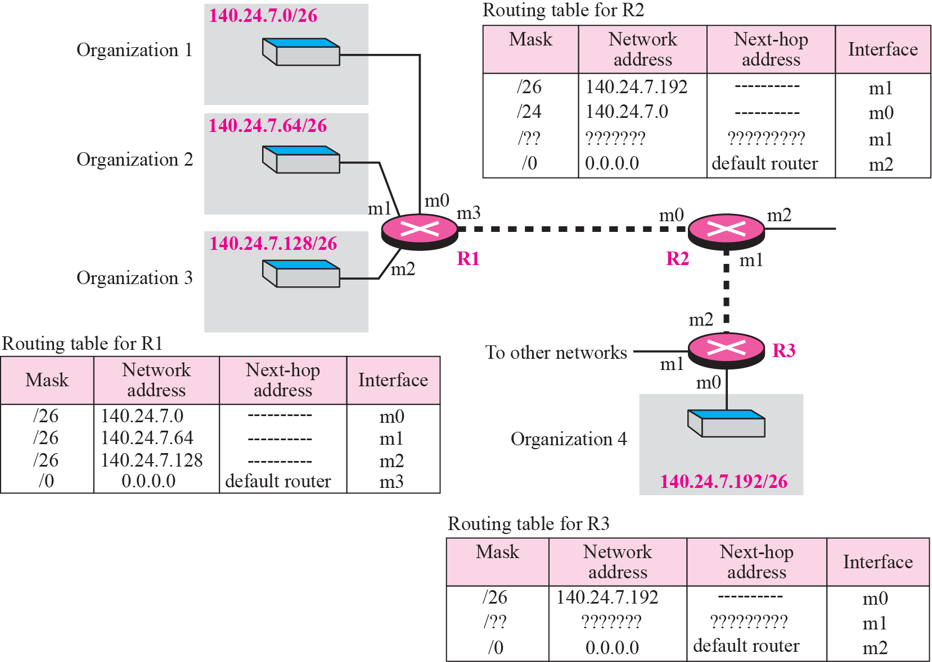
Longest mask matching
Example: Packet arrived at R2: 140.24.7.200.
TCP/IP Protocol Suite

Slide 57
Hierarchical routing with ISPs
To solve the problem of gigantic routing tables, we can create a hierarchy in the routing tables.
The Internet today has a sense of hierarchy. Internet is divided into backbone, regional and local ISPs.
If the routing table has a sense of hierarchy like the Internet architecture, the routing table can decrease in size.
Let us take the case of a local ISP. A local ISP can be assigned a single, but large, block of addresses with a certain prefix length.
The local ISP can divide this block into smaller blocks of different sizes, and assign these to individual users and organizations.
If the block assigned to the local ISP starts with a.b.c.d/n, the ISP can create blocks starting with e.f.g.h/m, where m may vary for each customer and is greater than n.
TCP/IP Protocol Suite

Slide 58
Hierarchical routing with ISPs
How to reduce the size of the routing table ?
All customers of the local ISP are defined as a.b.c.d/n to the rest of the Internet.
Every packet destined for one of the addresses in this large block is routed to the local ISP. There is only one entry in every router in the world for all of these customers.
Inside the local ISP, the router must recognize the subblocks and route the packet to the destined customer.
TCP/IP Protocol Suite

Slide 59
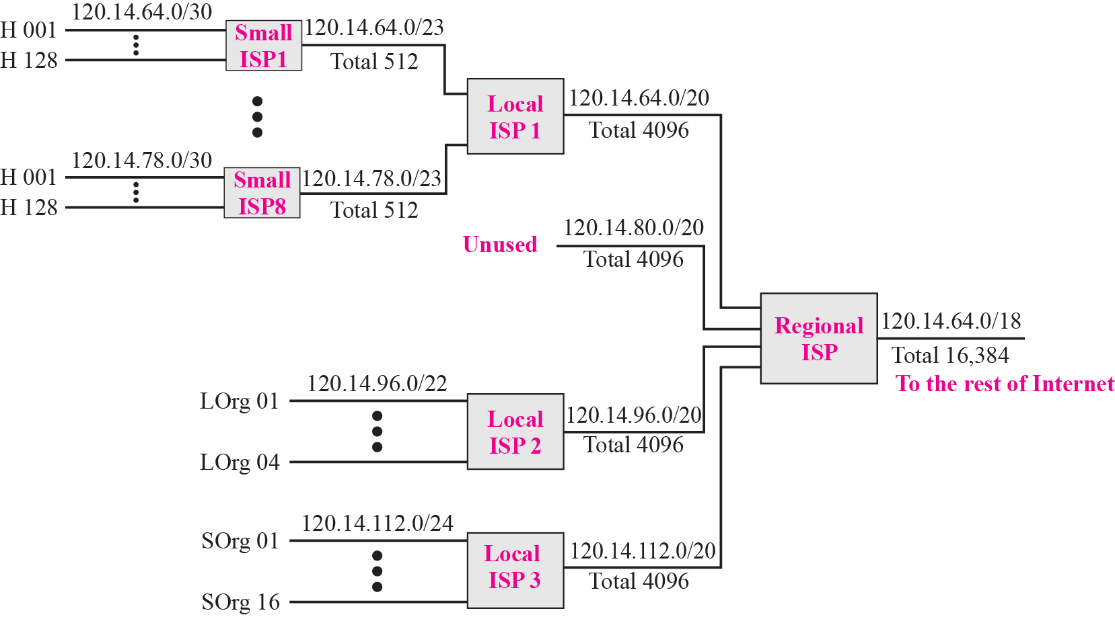
Figure 6.17 Hierarchical routing with ISPs
TCP/IP Protocol Suite

Slide 60
Geographical Routing
To decrease the size of the routing table even further, we need to extend hierarchical routing to include geographical routing.
We must divide the entire address space into a few large blocks.
We assign a block to America, a block to Europe, a block to Asia, a block to Africa, and so on.
The routers of ISPs outside of Europe will have only one entry for packets to Europe in their routing tables.
TCP/IP Protocol Suite

Slide 61
Routing Table Search Algorithms
Searching in Classful Addressing
In classful addressing, the routing table is organized as a list.
To make searching more efficient, the routing table can be divided into three tables (called buckets), one for each class.
When the packet arrives, the router applies the default mask to find the corresponding bucket (A, B, or C).
The router then searches the corresponding bucket instead of the whole table.
TCP/IP Protocol Suite

Slide 62
Searching in Classless Addressing
In classless addressing, there is no network information in the destination address.
The simplest, but not the most efficient, search method is called the longest prefix match.
The routing table can be divided into buckets, one for each prefix. The router first tries the longest prefix.
If the address is not found, the next prefix is searched. And so on.
It is obvious that this type of search takes a long time. One solution is to change the data structure used for searching.
Instead of a list, other data structures (such as a tree or a binary tree) can be used.
TCP/IP Protocol Suite

Slide 63
Forwarding Based on Label
In a connectionless network (datagram approach), a router forwards a packet based on the destination address.
In a connection-oriented network (virtual-circuit approach), a switch forwards a packet based on the label attached to a packet.
Routing is normally based on searching the contents of a table; switching can be done by accessing a table using an index.
In other words, routing involves searching; switching involves accessing.
TCP/IP Protocol Suite

Slide 64
Example 6.13
Figure shows example of searching in a routing table using the longest match algorithm.
When the forwarding algorithm gets the destination address of the packet, it needs to delve into the mask column.
For each entry, it needs to apply the mask to find the destination network address.
It then needs to check the network addresses in the table until it finds the match.
The router then extracts the next hop address and the interface number to be delivered to the ARP protocol for delivery of the packet to the next hop.
TCP/IP Protocol Suite

Slide 65
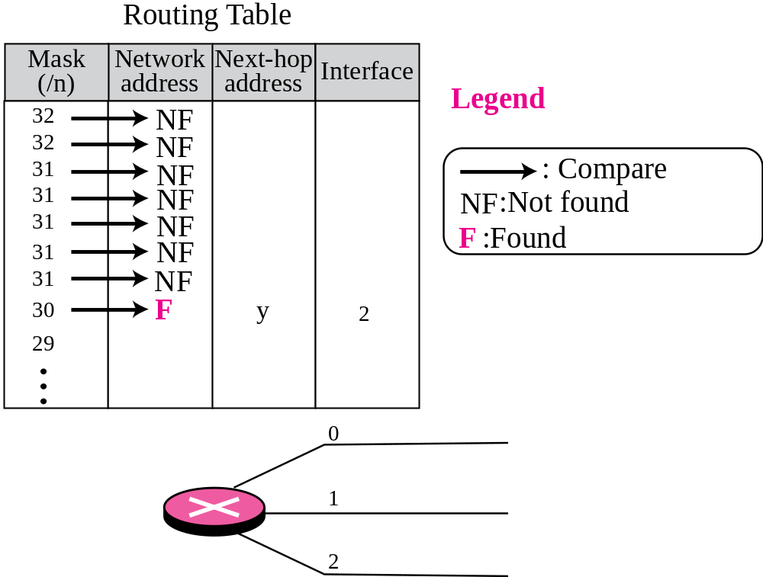
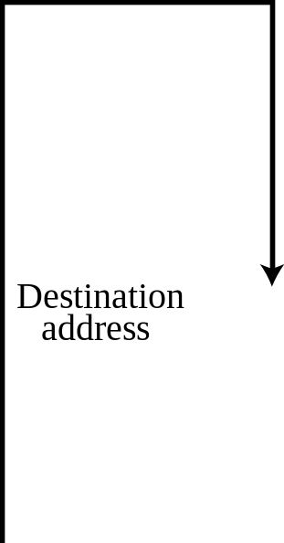
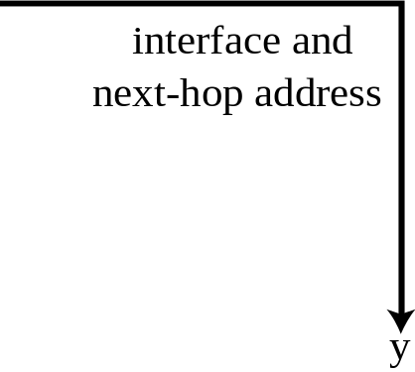

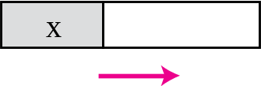
Figure 6.18 Example 6.13: Forwarding based on destination address
TCP/IP Protocol Suite

Slide 66
Example 6.14
Figure 6.19 shows a simple example of using a label to access a switching table.
Since the labels are used as the index to the table, finding the information in the table is immediate.
TCP/IP Protocol Suite

Slide 67
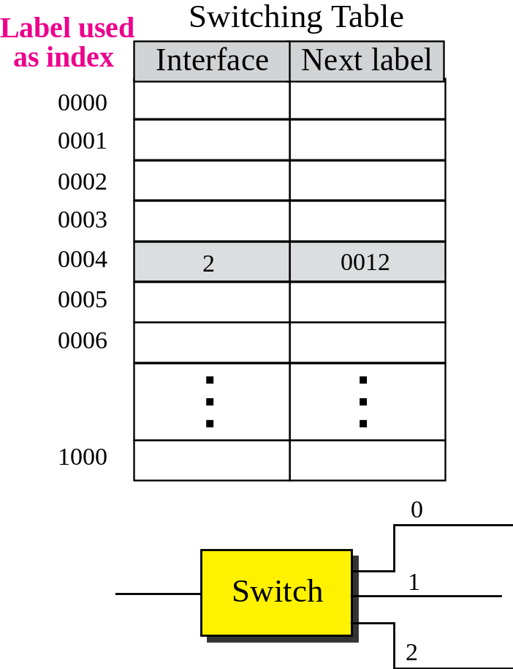
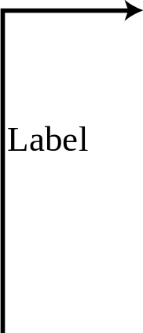
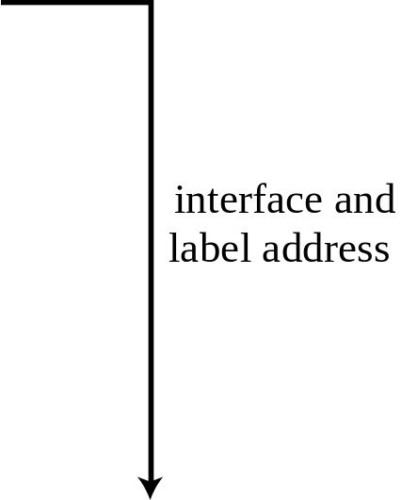

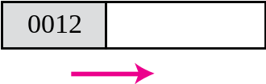
Figure 6.19 Example 6.14: Forwarding based on label
TCP/IP Protocol Suite
Notes:
interface and
label address interface and
label address 0012

Slide 68

MPLS (Multi Protocol Label Switching)
Here some conventional routers in the Internet can be replaced by MPLS routers that can behave like a router and a switch.
When behaving like a router, MPLS can forward the packet based on the destination address; when behaving like a switch, it can forward a packet based on the label.
To simulate connection-oriented switching using a protocol like IP, the first thing needed is to add a field to the packet that carry the label.
The whole IP packet is encapsulated as the payload in an MPLS packet and MPLS header is added.
TCP/IP Protocol Suite
Figure 6.20 MPLS header added to an IP packet
Notes:
interface and
label address interface and
label address 0012

Slide 69
END.
TCP/IP Protocol Suite
Notes:
interface and
label address interface and
label address 0012

